Slide 1

Prescription Label Reading
MINOR PROJECT
Project No. - 63
Swapnil Pant 201B278
Satyam Thakur 201B244
Utkarsh Mathur 201B294
Project Guide :
Dr. Nileshkumar R. Patel

Slide 2
Table of Contents
Serial No. | Title | Slide No.
1 | Introduction | 3
2 | Problem Statement | 4
3 | Solution | 5
4 | Block Diagram | 6
5 | What is OCR? | 7
6 | Technologies Used | 8 - 12
7 | Sample UI | 13
8 | Learning Outcomes | 14
9 | Target (until next Presentation) | 15
10 | References | 16

Slide 3

INTRODUCTION
Doctors in India are too busy to write digital prescriptions.
Prescription on paper can be tough to read and understand for the common folks.
After various attempts by our government, still this problem persists
Prescription reading will help solve the problem caused due to misinterpretation of prescriptions.

Slide 4
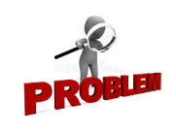
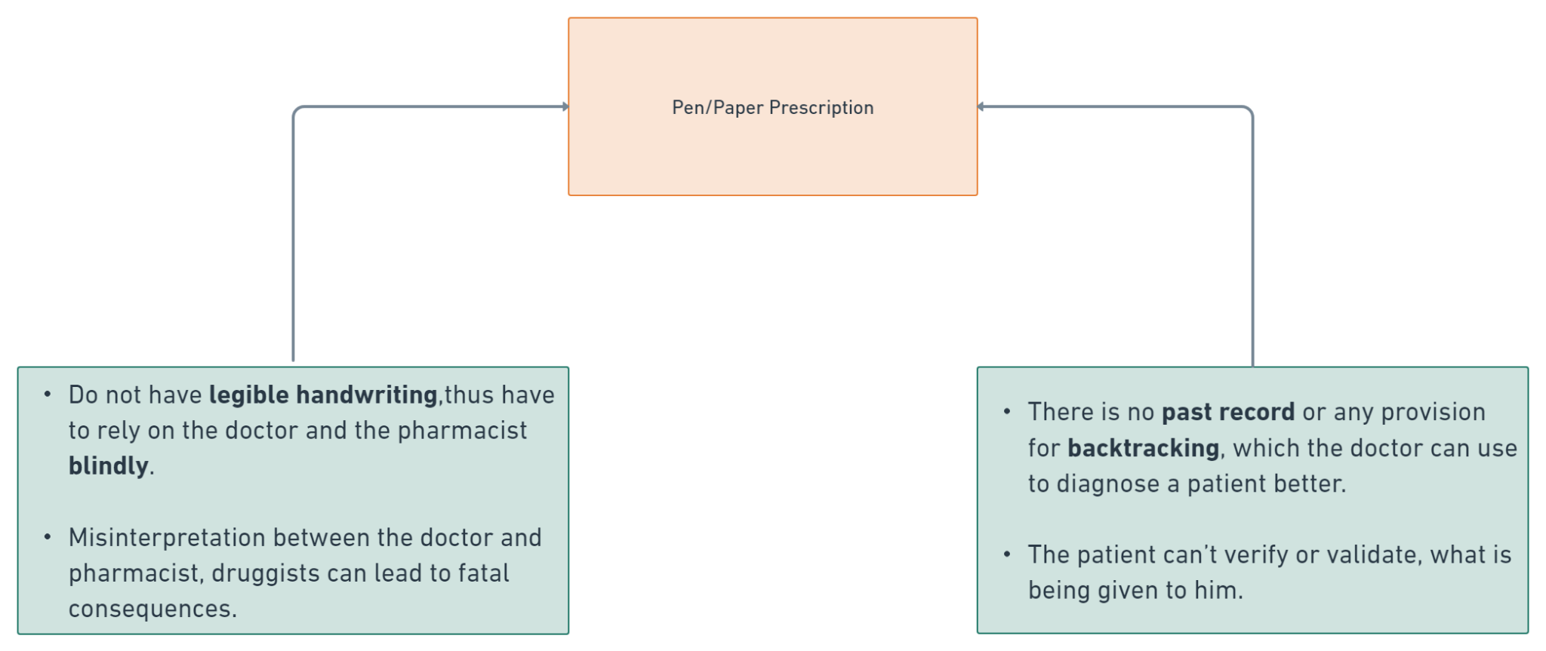
Problem Statement

Slide 5
Expected Outcome from this Project
SOLUTION
To build a solution that will recognize and identify the text in the prescriptions and should read out the name of medicines and dosage limits to the patients.
To build a deployable user interface or to expose our entire solution as an API.

Slide 6
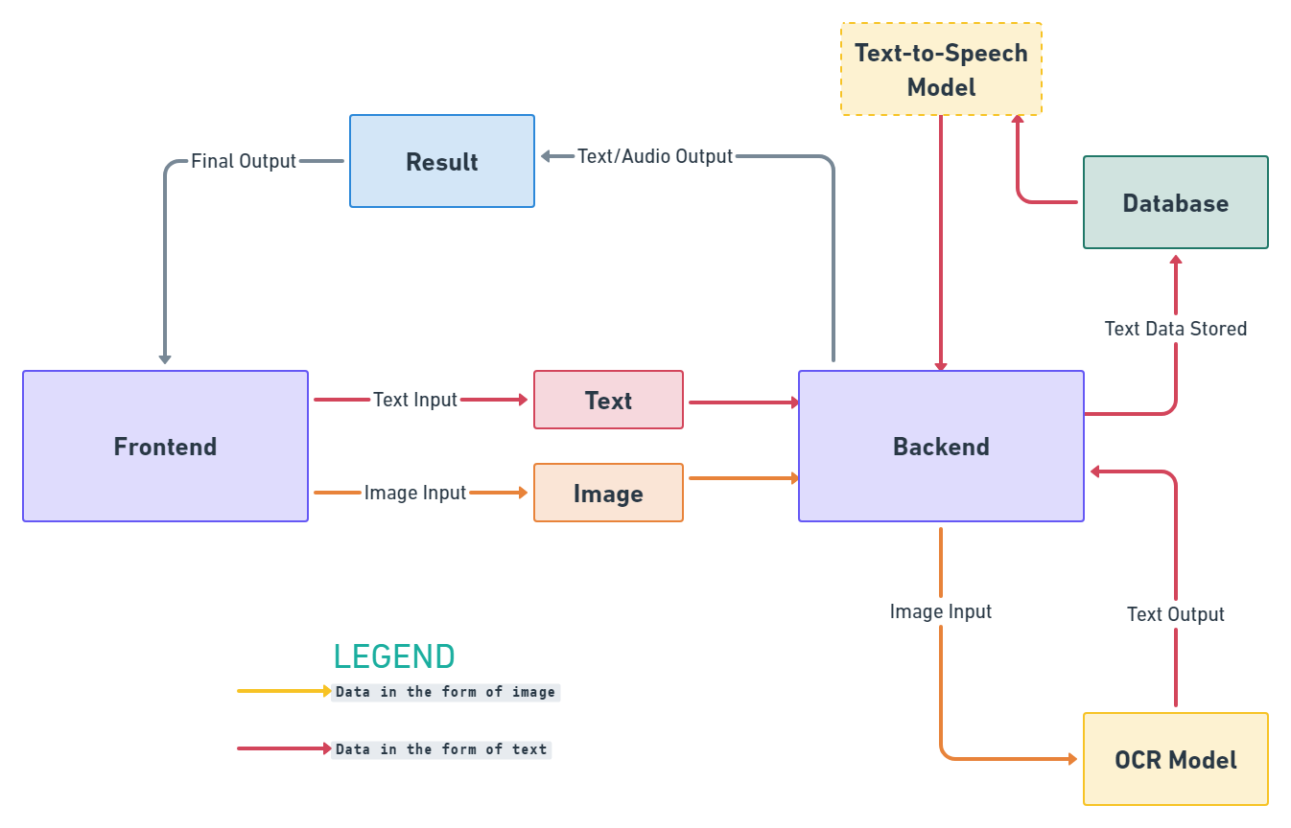
BLOCK DIAGRAM

Slide 7
What is OCR? And how does it work?
OCR stands for Optical Character Recognition/
It is the process that converts an image of text into a machine-readable text format.
The OCR engine works by using the following steps:
Image acquisition
Preprocessing
Text recognition
Pattern matching
Feature extraction
Post processing

Slide 8



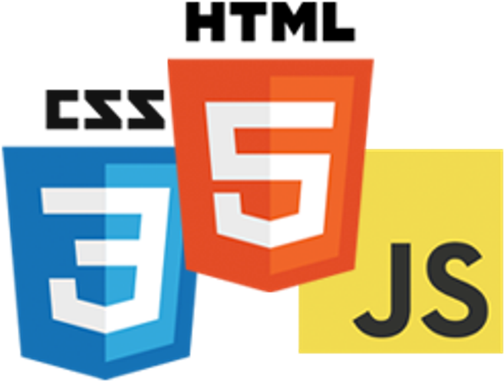


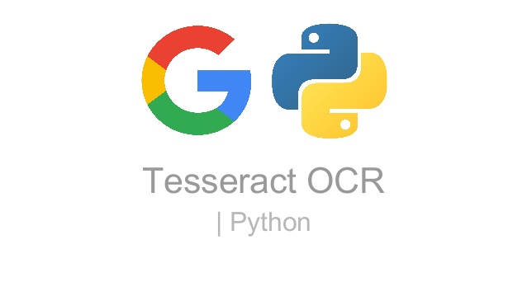
Tech Stack
Keras
Tensorflow
React.js
HTML, CSS, JS
Python
PyTesseract
Flask

Slide 9
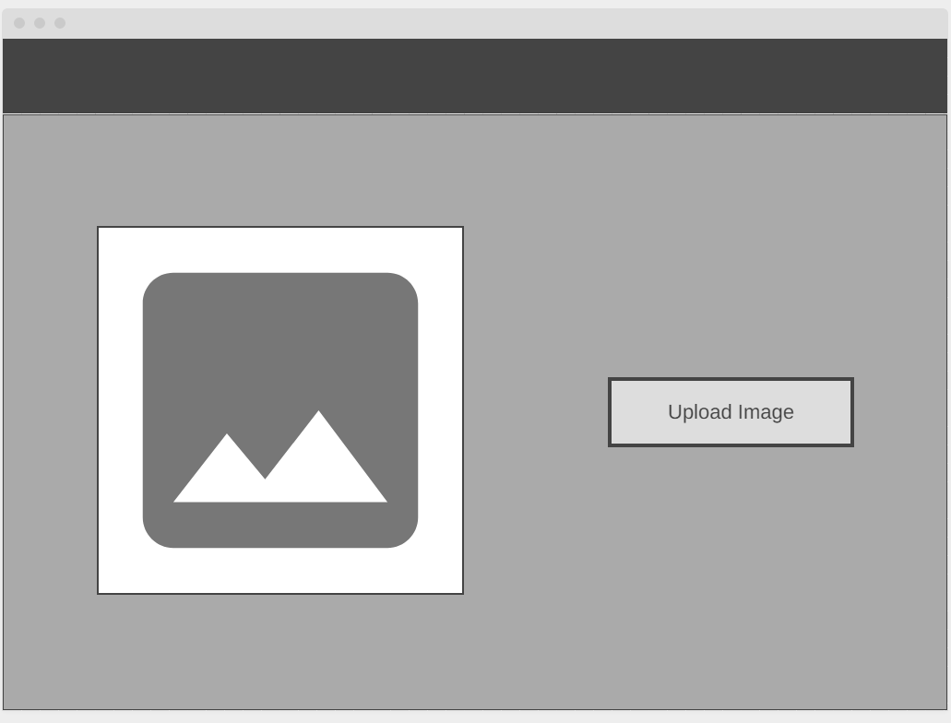
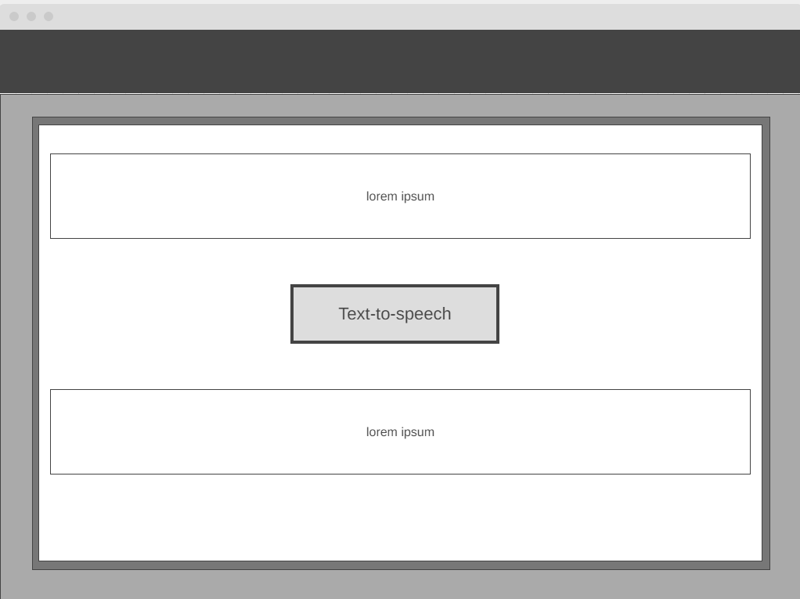
Sample UI

Slide 10
Learning Outcomes
To gain a solid understanding of Machine Learning fundamentals.
Learn the principles of deep learning and computer vision.
Know a variety of Optical Character Recognition Models thoroughly.
Learn how to deploy scalable applications and combine machine learning models with the front end.

Slide 11
Target (until Next Presentation)
Make an interactive application that is easy to use.
Prepare and train our optical character recognition working models (OCR).
Test the accuracy of our most recent models.

Slide 12
References :
Automating data extraction from prescription document images to reduce human error (MIT Research Paper)
Link: https://dspace.mit.edu/handle/1721.1/128575
Health Literacy Level and Comprehension of Prescription and Nonprescription Drug Information
Link: https://www.mdpi.com/1660-4601/19/11/6665
Klippa - Medical prescription OCR & data capturing
Link: https://www.klippa.com/en/ocr/medical-documents/medical-prescription/

